Slide 1
GIS React TypeScript Demo
By: George Pan
At: 12/25/2022

Slide 2
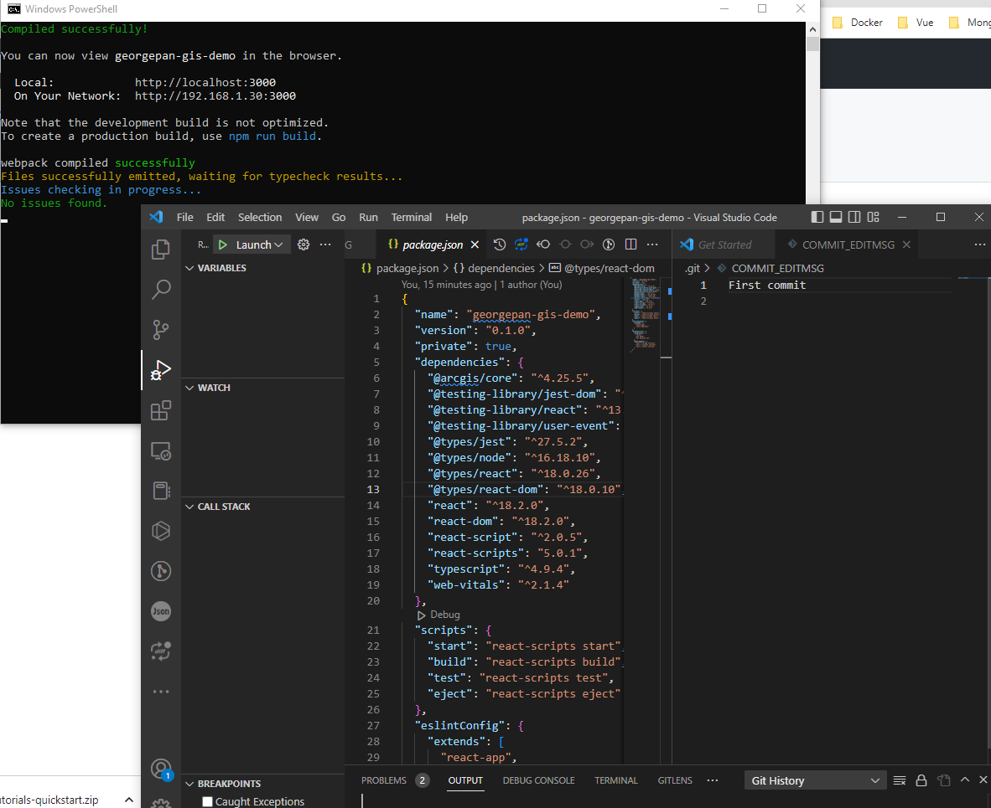

Slide 3
About This Web App
This is a simple demo web app made of:
ESRI JavaScript API
React
TypeScript
IDE:
VS Code
GIS Data Source:\
ESRI free sample data

Slide 4
Copyright
This demo is created quickly by George Pan for a job interview only. It is NOT copied from his any previous projects. George merged several pure ESRI JavaScript API code samples and converted them into React/TypeScript project.
It can’t be used for any business work without George Pan’s agreement.
It has simple / basic using of React hooks to show George’s skills. More advanced React/Redux/TypeScript/ESRI JS API code can be built in the real projects easily and quickly.

Slide 5
Basic Functions
Bae Map Gallery – Change base maps
Sketch – Draw geometries like line, point, polygon, rectangle, and circle
Print – Print the current map extent to a PDF file in multiple paper sizes
Search – find a location by address
Feature class – a sample feature layer
Identify – click a point of map and show the feature detail popup
Legend – show different crop harvest type in different color
Zoom in / out
Scale Bar

Slide 6
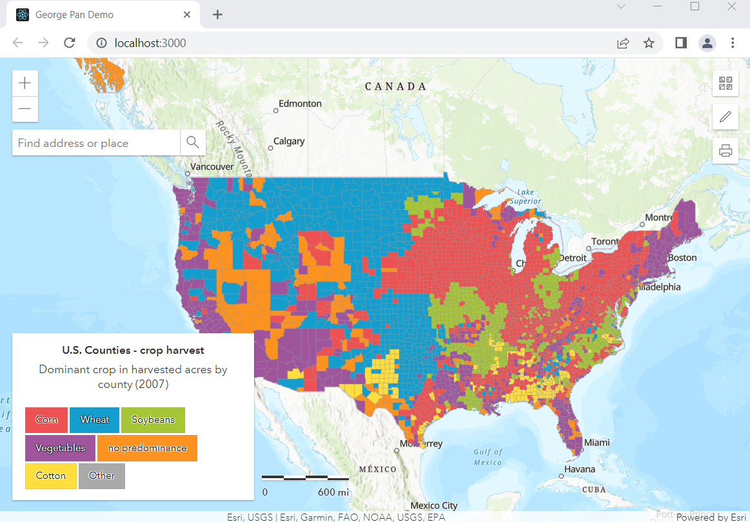
Overview

Slide 7
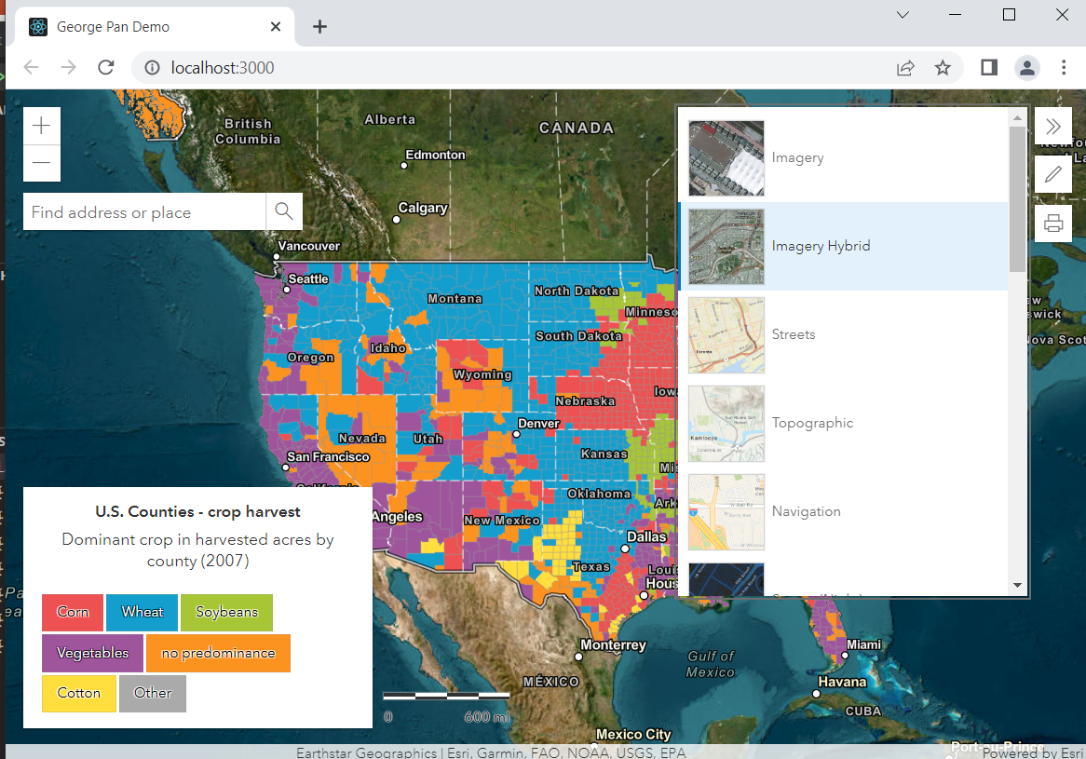
Overview

Slide 8
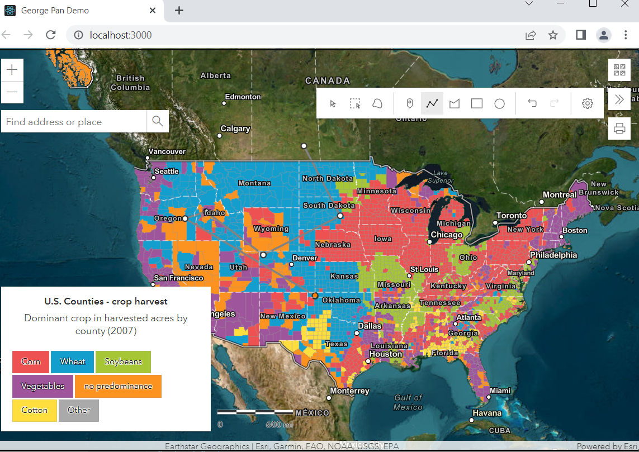
Overview

Slide 9
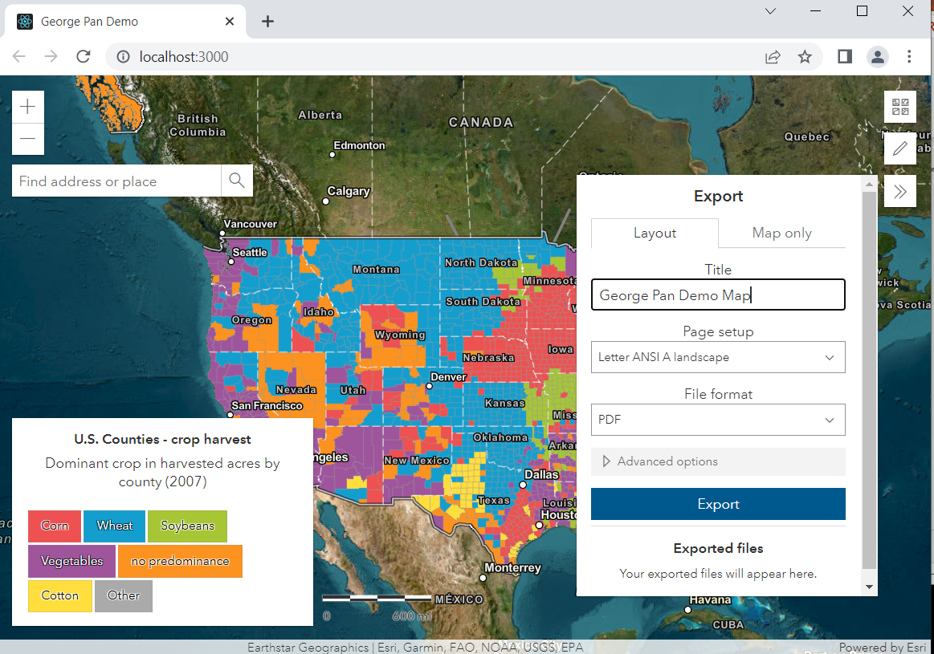
Overview

Slide 10
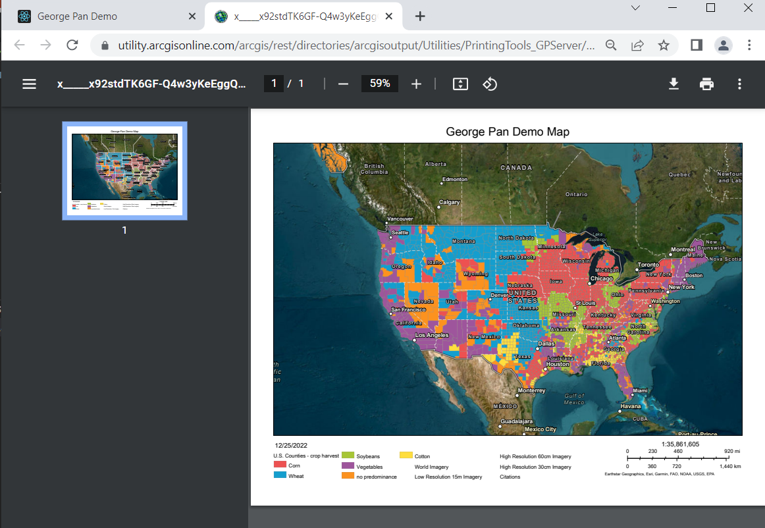

Slide 11
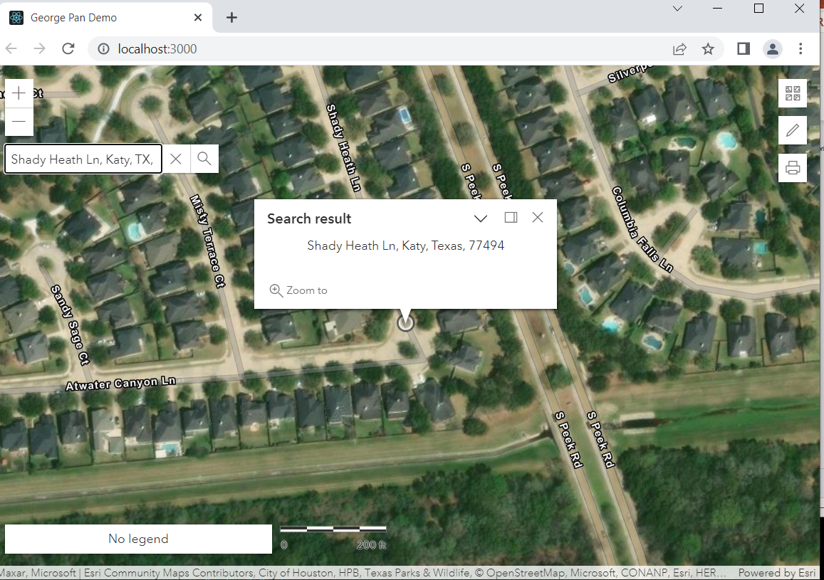

Slide 12
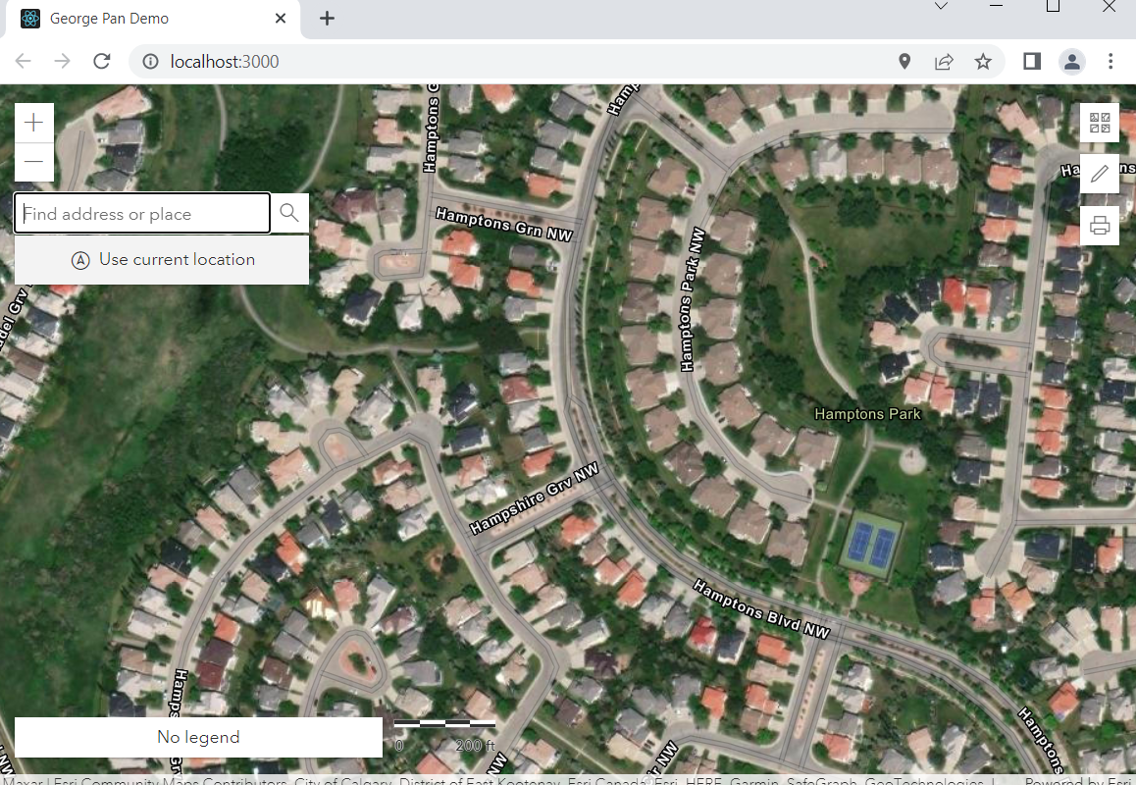

Slide 13
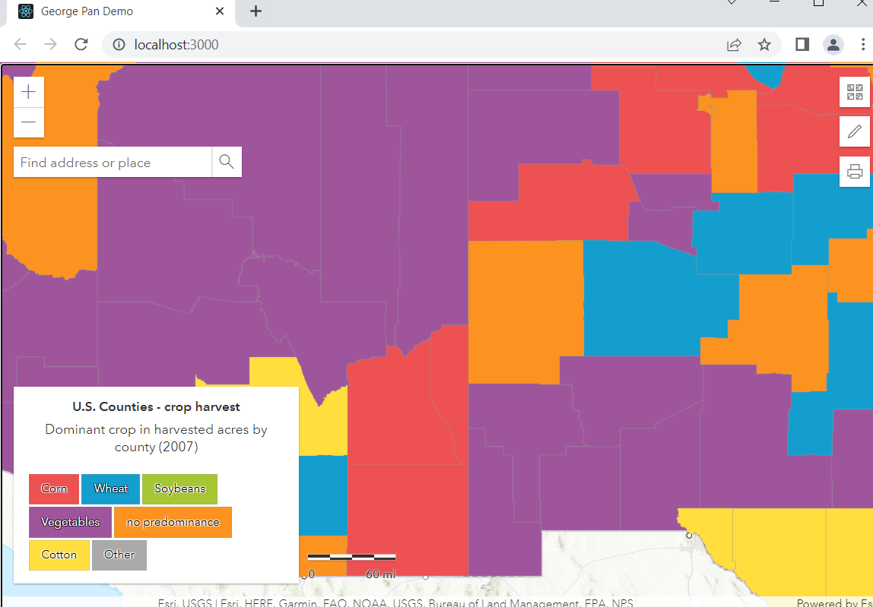

Slide 14
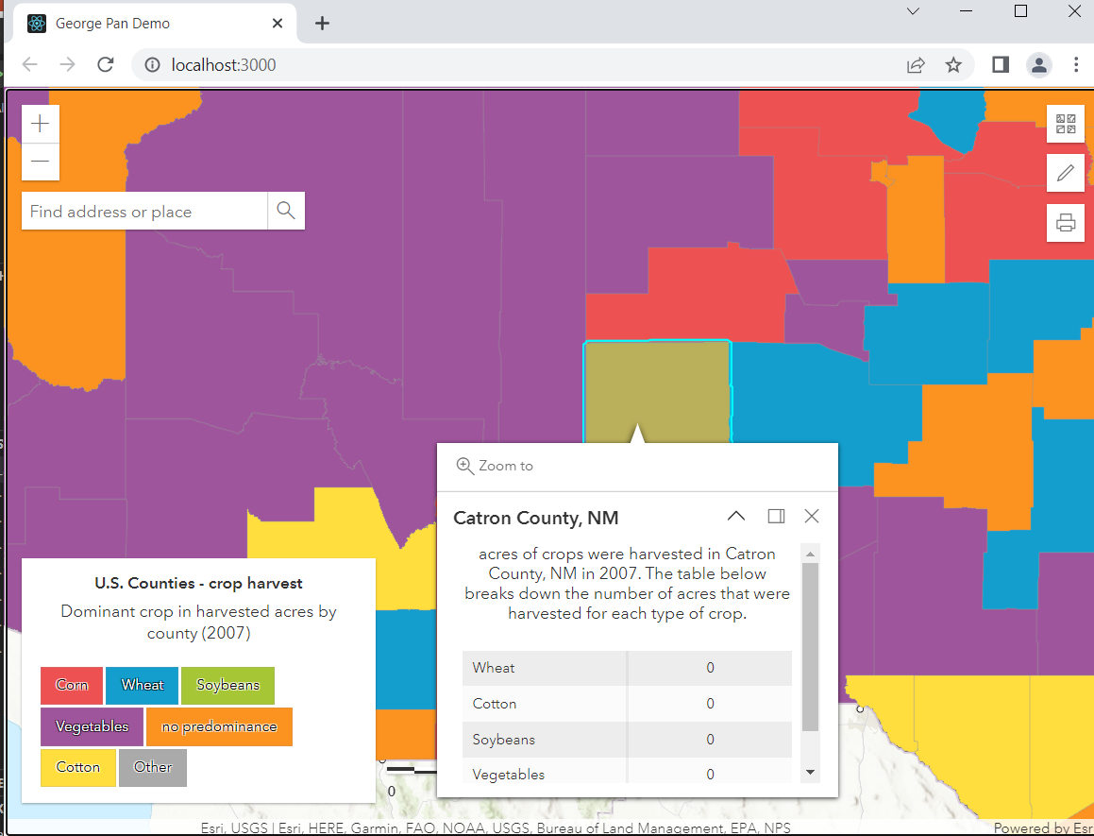

Slide 15
Thanks very much to your time The End

